Slide 1
Chapter 2: Relational Model

Slide 2
Contents
Structure of Relational Databases
Fundamental Relational-Algebra-Operations
Additional Relational-Algebra-Operations
Extended Relational-Algebra-Operations
Null Values
Modification of the Database

Slide 3
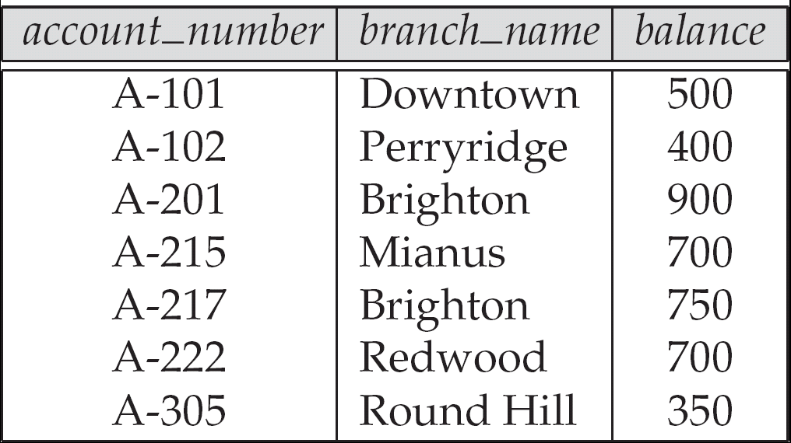
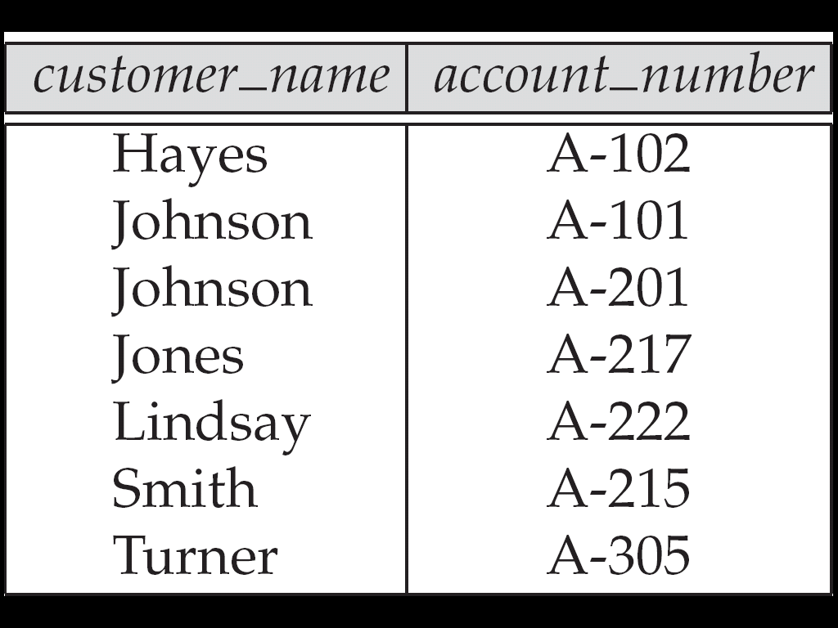
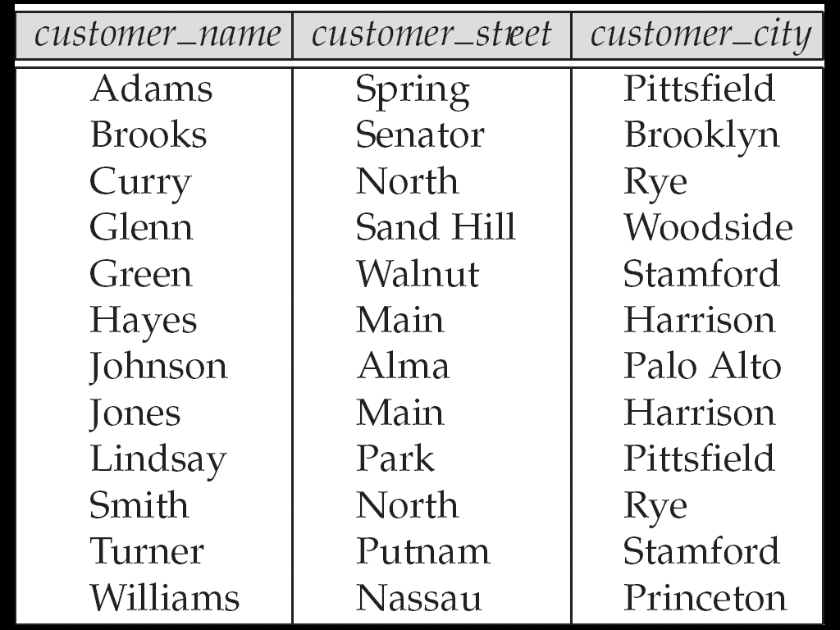
Structure of Relational Database
On the logical level, relational database is a collection of 2-D tables called Relations
relations represents
an entity set or
a relationship set
A row of a relation
represents a entity
or a relationship

Slide 4
Basic Structure
Each row of a relation can be referred to as tuple
Each column of a relation has a name ➔ named columns of a relation are referred to as attributes
The set of allowed values for each attribute is called the domain of the attribute

Slide 5
Basic structure
Cont.
Attribute values are (normally) required to be atomic; that is, indivisible
the value of a tuple on an attribute can be
an account number, but cannot be a set of account numbers
The special value null is a member of every domain

Slide 6
Example
Has 3 attributes ➔ customer_name, customer_street, customer_city
D1: The set of all possible customer names
D2: The set of all possible customer streets
D3: The set of all possible customer city
Relation customer is a subset of:
D1 ×D2×D3
Relation Customer
Tuple

Slide 7
Relation
Cartesian Product
Formally, given sets D₁, D₂, …. D_{n} a relation r is a subset of D₁ x D₂ x … x D_{n} Thus, a relation is a set of n-tuples (a₁, a₂, …, a_{n}) where each a_{i} ∈ D_{i}

Slide 8
Example
customer_name = {Jones, Smith, Curry, Lindsay, …}
customer_street = {Main, North, Park, …}
customer_city = {Harrison, Rye, Pittsfield, …}
Then relation r
customer_name customer_street customer_city
Jones Main Harrison Smith North Rye Curry North Rye Lindsay Park Pittsfield
is a relation over
customer_name x customer_street x customer_city

Slide 9

Tuple Variable
Tuple variable
is a variable that stands for a tuple
Whose domain is the set of all tuples of a particular relation
Example
t is a variable refer to a tuple in Account
t[Account_number]=
A-305
A-102
t[branch_name]=
Perryridge
Round Hill
t[balance]=
350
400

Slide 10
Relation Schema
A₁, A₂, …, A_{n} are attribute names
R = (A₁, A₂, …, A_{n} ) is a relation schema
customer_schema = (customer_name, customer_street, customer_city)
r(R) denotes a relation r on the relation schema R
customer (customer_schema)
The current values (relation instance) of a relation are specified by a table

Slide 11
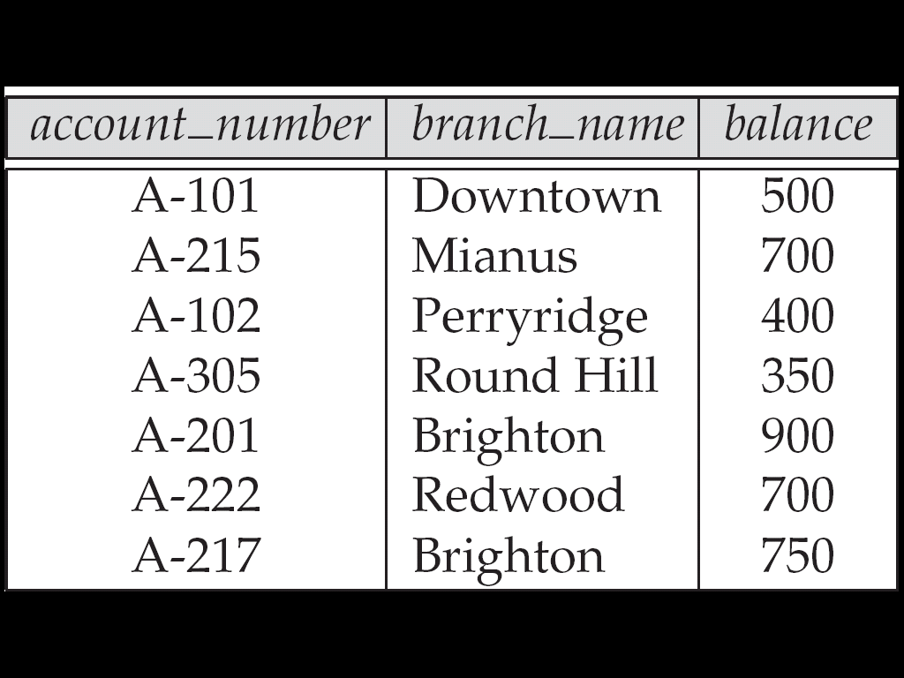
Relations are Unordered
Order of tuples is irrelevant (tuples may be stored in an arbitrary order)
Example
account relation with unordered tuples

Slide 12
Relational Database
A database consists of multiple relations
Information about an enterprise is broken up into parts, with each relation storing one part of the information
Example
account : stores information about accounts
depositor : stores information about which customer owns which account
customer : stores information about customers

Slide 13
Relational Database
Cont.
Storing all information as a single relation
repetition of information
the need for null values
Normalization theory (Chapter 7) deals with how to design relational schemas
bank(account_number, balance, customer_name, ....)
Result in
if two customers own an account (What gets repeated?)
to represent a customer without an account

Slide 14
The Account Relation

Slide 15

The customer Relation

Slide 16

The depositor Relation

Slide 17
Keys
K is a set of attributes, let K ⊆ R
K is a superkey of R if values for K are sufficient to identify a unique tuple of each possible relation r(R)
by “possible r ” we mean a relation r that could exist in the enterprise we are modeling.

Slide 18
Example
If no two customers can possibly have the same name，{customer_name, customer_street} and {customer_name} are both superkeys of customer

Slide 19
Keys
Cont.
Superkey K is a candidate key if K is minimal
Minimal means no subset of it is superkey
Example
{customer_name} is a candidate key for customer, since it is a superkey and no subset of it is a superkey.

Slide 20
Keys
Cont.
Primary key: a candidate key chosen as the principal means of identifying tuples within a relation
Should choose an attribute whose value never, or very rarely, changes.
Example
email address is unique, but may change,
is not suitable for primary key

Slide 21
Foreign Keys
A relation r1 may have an attribute that corresponds to the primary key of another relation r2. The attribute is called a foreign key
r1 is referencing relation
r2 is referenced relation
Example
customer_name and account_number attributes of depositor are foreign keys to customer and account respectively. depositor is referencing relation, customer and account are referenced relation

Slide 22

Example
Referenced relation
Referenced relation
Primary Key
Foreign Key, Corresponds to the primary key of relation Account
Foreign Key, Corresponds to the primary key of relation Customer
Referencing relation

Slide 23
Referencing Constraint
Only values occurring in the primary key attribute of the referenced relation may occur in the foreign key attribute of the referencing relation
Is subset of…

Slide 24
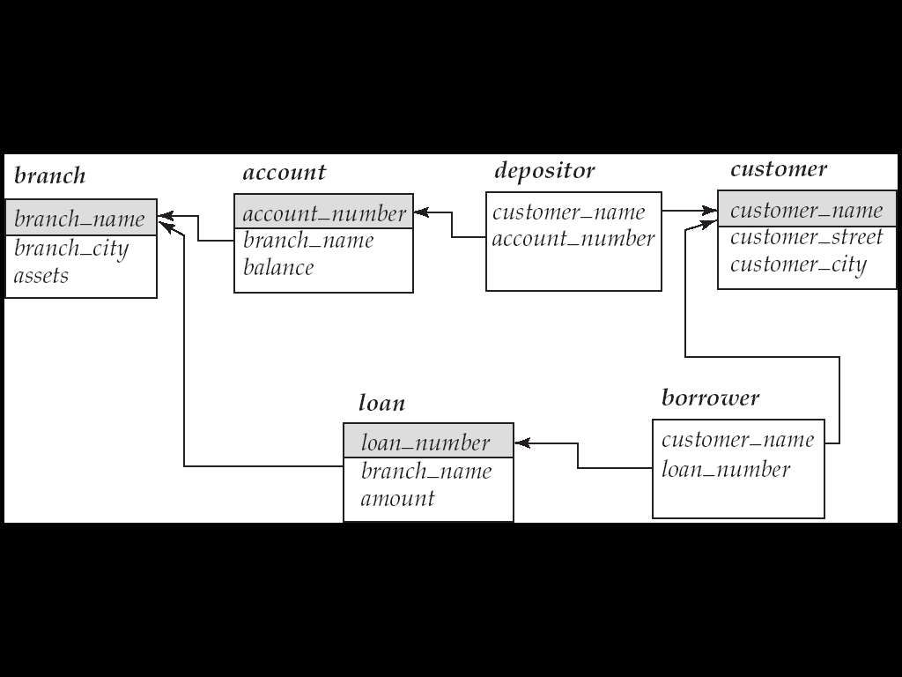
Schema Diagram

Slide 25
Query Languages
Language in which user requests information from the database.
Categories of languages
Procedural
Non-procedural, or declarative
“Pure” languages:
Relational algebra
Tuple relational calculus
Domain relational calculus
form underlying basis of query languages that people use
Procedural
Nonprocedural

Slide 26
Relational Algebra
Consists of a set of operators take one or two relations as inputs and produce a new relation as a result
Six basic operators
select: σ
project: ∏
union: ∪
set difference: –
cartesian product: x
rename: ρ

Slide 27
Select Operation
Select tuples that satisfy a given prodicate
Example
Relation r
σ_{A=B ^ D > 5} (r)
A
B
C
D
A
B
C
D
α
α
β
β
α
β
β
β
1
5
12
23
7
7
3
10
α
β
α
β
1
23
7
10

Slide 28
Select Operation
Cont.
Notation: σ _{p}(r)
Defined as:
selection predicate
σ_{p}(r) = {t | t ∈ r and p(t)}
Where p is a formula in propositional calculus consisting of terms connected by : ∧ (and), ∨ (or), ¬ (not)，Each term is one of:
<attribute> op <attribute> or <constant>
where op is one of: =, ≠, >, ≥. <. ≤

Slide 29
Example
Find the basic information of all students who’s age is bellow 20
σ _{Sage < 20} (Student) σ _{4 < 20} (Student)
Sno
Sname
Ssex
Sage
Sdept
95001
李勇
男
20
CS
95002
刘晨
女
19
IS
95003
王敏
女
18
MA
95004
张立
男
19
IS
95002
刘晨
女
19
IS
95003
王敏
女
18
MA
95004
张立
男
19
IS

Slide 30
Project Operation
A Unary operation, picking certain columns
Example
Relation r
∏_{A,C} (r)
A
B
C
A
C
A
C
α
α
β
β
10
20
30
40
1
1
1
2
α
α
β
β
1
1
1
2
α
β
β
1
1
2

Slide 31
Project Operation
Cont.
Notation:
The result is defined as the relation of k columns obtained by erasing the columns that are not listed
Duplicate rows removed from result, since relations are sets
attribute names

Slide 32
Example
Find the names and the departments of all students
∏_{Sname,Sdept}(Student) or ∏ _{2,5}(Student)
Sno
Sname
Ssex
Sage
Sdept
Sname
Sdept
95001
李勇
男
20
CS
李勇
CS
95002
刘晨
女
19
IS
刘晨
IS
95003
95004
王敏
女
18
MA
王敏
MA
张立
男
19
IS
张立
IS

Slide 33
Union Operation
Analogous to set union operation
Example
r
s
r ∪ s
A
B
A
B
A
B
α
α
β
1
2
1
α
β
2
3
α
α
β
β
1
2
1
3

Slide 34
Union Operation
Notation: r ∪ s
Defined as:
r ∪ s = {t | t ∈ r or t ∈ s}
For r ∪ s to be valid.
1. r, s must have the same arity (same number of attributes)
2. The attribute domains must be compatible
2nd column of r deals with the same type of values as does the 2nd column of s

Slide 35
Set Difference Operation
Analogous to set difference operation
Example
r
s
r – s
A
B
A
B
A
B
α
α
β
1
2
1
α
β
2
3
α
β
1
1

Slide 36
Set Difference Operation
Notation r – s
Defined as:
Set differences must be taken between compatible relations.
r and s must have the same arity
attribute domains of r and s must be compatible
r – s = {t | t ∈ r and t∉s }

Slide 37
Cartesian-Product Operation
Pair each tuple of one relation with each tuple of another
r x s
Example
s
A
B
C
D
E
r
C
D
E
α
α
α
α
β
β
β
β
1
1
1
1
2
2
2
2
α
β
β
γ
α
β
β
γ
10
10
20
10
10
10
20
10
a
a
b
b
a
a
b
b
A
B
α
β
β
γ
10
10
20
10
a
a
b
b
α
β
1
2

Slide 38
Cartesian-Product Operation
Notation r x s
Defined as:
Assume that attributes of r(R) and s(S) are disjoint. (That is, R ∩ S = ∅).
If attributes of r(R) and s(S) are not disjoint, then renaming must be used
r x s = {t q | t ∈ r and q ∈ s}

Slide 39
Composition of Operations
Can build expressions using multiple operations
Example
A
B
C
D
E
σ_{A=C}(r x s)
α
α
α
α
β
β
β
β
1
1
1
1
2
2
2
2
α
β
β
γ α
β
β
γ
10
10
20
10
10
10
20
10
a
a
b
b
a
a
b
b
A
B
C
D
E
r x s
α
β
β
1
2
2
α
β
β
10
10
20
a
a
b

Slide 40
Example
Find the names of all customers who have an account at the bank, along with the account number and the balance
∏customer_name, account.account_number, balance
σ account.account_number=customer.accoont_number
(
account × customer
(
)
)

Slide 41
Rename Operation
Allows us to name, and therefore to refer to, the results of relational-algebra expressions
Allows us to refer to a relation by more than one name
ρ _{x} (E)
returns the expression E under the name X
returns the result of expression E under the name X, and with the attributes renamed to A1 , A2 , …., An

Slide 42
Example
Find the names of all customers who live in the same city as smith
∏_{customer.customer_name}
(
σ _{customer.customer_city =}
_{smith_info.customer_city}
_{?.cutomer._city}
(
customer×
(customer×ρ _{smith_infor}
σ _{customer_name=“smith”} (customer)
)
)
(
)

Slide 43
Banking Example
branch (branch_name, branch_city, assets)
customer (customer_name, customer_street, customer_city)
account (account_number, branch_name, balance)
loan (loan_number, branch_name, amount)
depositor (customer_name, account_number)
borrower (customer_name, loan_number)

Slide 44
Example Queries
Find all loans of over $1200
Find the loan number for each loan of an amount greater than $1200
Find the names of all customers who have a loan, an account, or both, from the bank
σ_{amount > 1200} (loan)
∏_{loan_number} (σ_{amount} _{> 1200} (loan))
∏_{customer_name} (borrower)
∪ ∏_{customer_name} (depositor)

Slide 45
Example Queries
Cont.
Find the names of all customers who have a loan at the Perryridge branch
Find the names of all customers who have a loan at the Perryridge branch but do not have an account at any branch of the bank
∏_{customer_name} (σ_{branch_name=“Perryridge”}
(σborrower.loan_number = loan.loan_number(borrower x loan)))
∏_{customer_name} (σ_{branch_name = “Perryridge”}
(σborrower.loan_number = loan.loan_number(borrower x loan))) – ∏_{customer_name}(depositor)

Slide 46
Example Queries
Cont.
Find the names of all customers who have a loan at the Perryridge branch
Query 1 ∏_{customer_name} (σ_{branch_name = “Perryridge”} ( σborrower.loan_number = loan.loan_number (borrower x loan)))
Query 2
∏_{customer_name}(σloan.loan_number = borrower.loan_number ((σ_{branch_name = “Perryridge”} (loan)) x borrower))

Slide 47
Example Queries
Cont.
Find the largest account balance
Strategy:
Find those balances that are not the largest
Rename account relation as d so that we can compare each account balance with all others
Use set difference to find those account balances that were not found in the earlier step.
The query is:
∏_{balance}(account) - ∏_{account.balance}
(σ_{account.balance < d.balance} (account x ρ_{d} (account)))

Slide 48
Additional Operations
We define additional operations that do not add any power to the relational algebra, but that simplify common queries
Set intersection ∩
Natural join
Division ÷
Assignment ←

Slide 49
Set-Intersection Operation
Notation: r ∩ s
Defined as:
Assume:
r, s have the same arity
attributes of r and s are compatible
Note: r ∩ s = r – (r – s)
r ∩ s = { t | t ∈ r and t ∈ s }

Slide 50
Example
r
s
r ∩ s
A B
A B
A B
α
α
β
1
2
1
α
β
2
3
α
2

Slide 51
Natural-Join Operation
Notation: r s
Let r and s be relations on schemas R and S respectively. Then, r s is a relation on schema R ∪ S obtained as follows:
Consider each pair of tuples t_{r} from r and t_{s} from s.
If t_{r} and t_{s} have the same value on each of the attributes in R ∩ S, add a tuple t to the result

Slide 52
Example
Natual-Join connects two relations by:
Equating attributes of the same name
And Projecting out one copy of each pair of equated attributes.
r
A
B
C
D
α
β
γ
α
δ
1
2
4
1
2
α
γ
β
γ
β
a
a
b
a
b
r s
A
B
C
D
E
α
α
α
α
δ
1
1
1
1
2
α
α
γ
γ
β
a
a
a
a
b
α
γ
α
γ
δ
B
D
E
s
1
3
1
2
3
a
a
a
b
b
α
β
γ
δ
∈

Slide 53
Division Operation
r ÷ s
Notation:
Let r and s be relations on schemas R and S respectively, where R = (A₁, …, A_{m} , B₁, …, B_{n} ) S = (B₁, …, B_{n})
The result of r ÷ s is a relation on schema
R – S = (A₁, …, A_{m})
r ÷ s = { t | t ∈ ∏ _{R-S} (r) ∧ ∀ u ∈ s ( tu ∈ r ) }
Where tu means the concatenation of tuples t and u to produce a single tuple

Slide 54
Example
r
A
B
α
α
α
β
γ
δ
δ
δ
∈
∈
β
1
2
3
1
1
1
3
4
6
1
2
s
r ÷ s
B
A
1
2
α
β

Slide 55
Example
r
A
B
C
D
E
s
r ÷ s
α
α
α
β
β
γ
γ
γ
a
a
a
a
a
a
a
a
α
γ
γ
γ
γ
γ
γ
β
a
a
b
a
b
a
b
b
1
1
1
1
3
1
1
1
D
E
A
B
C
a
b
1
1
α
γ
a
a
γ
γ

Slide 56
Division Operation
Cont.
Definition in terms of the basic algebra operation Let r(R) and s(S) be relations, and let S ⊆ R r ÷ s =
∏_{R-S} (r ) – ∏_{R-S} ( ( ∏_{R-S} (r ) x s ) – ∏_{R-S,S}(r )) To see why
∏_{R-S,S} (r) simply reorders attributes of r
∏_{R-S} (∏_{R-S} (r ) x s ) – ∏_{R-S,S}(r) ) gives those tuples t in ∏_{R-S} (r ) such that for some tuple u ∈ s, tu ∉ r

Slide 57
Assignment Operation
The assignment operation (←) provides a convenient way to express complex queries.
Write query as a sequential program consisting of
a series of assignments
followed by an expression whose value is displayed as a result of the query.
Assignment must always be made to a temporary relation variable.

Slide 58
Assignment Operation
Cont.
Example
Write r ÷ s as
temp1 ← ∏_{R-S} (r ) temp2 ← ∏_{R-S} ((temp1 x s ) – ∏_{R-S,S} (r )) result = temp1 – temp2
The result to the right of the ← is assigned to the relation variable on the left of the ←.
May use variable in subsequent expressions

Slide 59
Example Queries
Find the names of all customers who have a loan and an account at bank
∏_{customer_name} (borrower) ∩ ∏_{customer_name} (depositor)
Find the name of all customers who have a loan at the bank and the loan amount
∏customer_name, loan_number, amount (borrower loan)

Slide 60
Example Queries
Cont.
Find all customers who have an account from at least the “Downtown” and the “Uptown” branches.
Query 1
∏_{customer_name} (σ_{branch_name = “Downtown”} (depositor account )) ∩ ∏_{customer_name} (σ_{branch_name = “Uptown”} (depositor account))
Query 2
∏_{customer_name, branch_name} (depositor account) ÷ ρ_{temp(branch_name)} ({(“Downtown” ), (“Uptown” )})

Slide 61
Example Queries
Cont.
Find all customers who have an account at all branches located in Brooklyn city
∏_{customer_name, branch_name} (depositor account) ÷ ∏_{branch_name} (σ_{branch_city = “Brooklyn”} (branch))

Slide 62
Extended Operations
Generalized Projection (广义投影)
Aggregate Functions
Outer Join

Slide 63
Generalized Projection
Extends the projection operation by allowing arithmetic functions to be used in the projection list
E is any relational-algebra expression
Each of F₁, F₂, …, F_{n} are arithmetic expressions involving constants and attributes in the schema of E.

Slide 64
Generalized Projection
Example
Given relation
credit_info(customer_name, limit, credit_balance),
find how much more each person can spend:
∏customer_name, limit – credit_balance (credit_info)

Slide 65
Aggregate Functions
Aggregate function takes a collection of values and returns a single value as a result
avg: average value min: minimum value max: maximum value sum: sum of values count: number of values

Slide 66
Aggregate Operations
Aggregate operation in relational algebra
Example
A
B
C
g _{sum(c)} (r)
α
α
β
β
α
β
β
β
7
7
3
10
r
sum(c )
27

Slide 67
Aggregate Operations
Relation E
Grouping
G1, G2, …, Gn
F1(A1), F2(A2), …, Fn(An)

Slide 68
Example
branch_name
account_number
balance
Perryridge
Perryridge
Brighton
Brighton
Redwood
A-102
A-201
A-217
A-215
A-222
400
900
750
750
700
_{branch_name} g _{sum(balance)} (account)
branch_name
sum(balance)
Perryridge
Brighton
Redwood
1300
1500
700

Slide 69
Aggregate Operations
Cont.
Result of aggregation does not have a name
Can use rename operation to give it a name
For convenience, we permit renaming as part of aggregate operation
_{branch_name} g _{sum(balance)} (account)
_{branch_name} g _{sum(balance) as sum-balance} (account)

Slide 70
Outer Join
An extension of the join operation that avoids loss of information
Computes the join and then adds tuples form one relation that does not match tuples in the other relation to the result of the join
Uses null values:
null signifies that the value is unknown or does not exist
All comparisons involving null are (roughly speaking) false by definition.

Slide 71
Example
Relation loan
loan_number
branch_name
amount
L-170
L-230
L-260
Downtown
Redwood
Perryridge
3000
4000
1700
Relation borrower
customer_name
loan_number
Jones
Smith
Hayes
L-170
L-230
L-155

Slide 72
Example
Join
loan borrower
loan_number
branch_name
amount
customer_name
L-170
L-230
Downtown
Redwood
3000
4000
Jones
Smith
Left Outer Join
loan borrower
loan_number
branch_name
amount
customer_name
L-170
L-230
L-260
Downtown
Redwood
Perryridge
3000
4000
1700
Jones
Smith
null

Slide 73
Example
Right Outer Join
loan borrower
loan_number
branch_name
amount
customer_name
L-170
L-230
L-155
Downtown
Redwood
null
3000
4000
null
Jones
Smith
Hayes
Full Outer Join
loan borrower
loan_number
branch_name
amount
customer_name
L-170
L-230
L-260
L-155
Downtown
Redwood
Perryridge
null
3000
4000
1700
null
Jones
Smith
null
Hayes

Slide 74
Null Values
It is possible for tuples to have a null value, denoted by null, for some of their attributes
null signifies an unknown value or that a value does not exist.
The result of any arithmetic expression involving null is null
Aggregate functions simply ignore null values (as in SQL)

Slide 75
Null Values
Cont.
For duplicate elimination and grouping, null is treated like any other value, and two nulls are are assumed to be the same
Comparisons with null values return the special truth value: unknown
Result of select predicate is treated as false if it evaluates to unknown

Slide 76
Null Values
Cont.
Three-valued logic using the truth value unknown:
OR: (unknown or true) = true, (unknown or false) = unknown (unknown or unknown) = unknown
AND: (true and unknown) = unknown, (false and unknown) = false, (unknown and unknown) = unknown
NOT: (not unknown) = unknown
In SQL “P is unknown” evaluates to true if predicate P evaluates to unknown

Slide 77
Modification of the Database
The content of the database may be modified using the following operations:
Deletion
Insertion
Updating
All these operations are expressed using the assignment operator

Slide 78
Deletion
A delete request is expressed similarly to a query, except instead of displaying tuples to the user, the selected tuples are removed from the database.
Can delete only whole tuples; cannot delete values on only particular attributes
A deletion is expressed in relational algebra by:
r ← r – E
where r is a relation and E is a relational algebra query

Slide 79
Example
Delete all account records in the Perryridge branch
account ← account – σ _{branch_name = “Perryridge”} (account )
Delete all loan records with amount in the range of 0 to 50
loan ← loan – σ _{amount ≥ 0 and amount ≤ 50} (loan)

Slide 80
Example
Delete all accounts at branches located in Needham.
r₁ ← σ _{branch_city = “Needham”} (account branch )
r₂ ← ∏ _{account_number,} _{branch_name, balance} (r₁)
r₃ ← ∏ _{customer_name, account_number} (r₂ depositor)
account ← account – r₂
depositor ← depositor – r₃

Slide 81
Insertion
To insert data into a relation, we either:
specify a tuple to be inserted
write a query whose result is a set of tuples to be inserted
in relational algebra, an insertion is expressed by:
r ← r ∪ E
where r is a relation and E is a relational algebra expression
The insertion of a single tuple is expressed by letting E be a constant relation containing one tuple.

Slide 82
Example
Insert information in the database specifying that Smith has $1200 in account A-973 at the Perryridge branch
account ← account ∪ {(“A-973”, “Perryridge”, 1200)}
depositor ← depositor ∪ {(“Smith”, “A-973”)}
Provide as a gift for all loan customers in the Perryridge branch, a $200 savings account. Let the loan number serve as the account number for the new savings account.
r₁ ← (σ_{branch_name = “Perryridge”} (borrower loan))
account ← account ∪ ∏_{loan_number, branch_name, 200} (r₁)
depositor ← depositor ∪ ∏_{customer_name, loan_number} (r₁)

Slide 83
Updating
A mechanism to change a value in a tuple without charging all values in the tuple
Use the generalized projection operator to do this task
Each F_{i} is either
the I ^{th} attribute of r, if the I ^{th} attribute is not updated, or,
if the attribute is to be updated F_{i} is an expression, involving only constants and the attributes of r, which gives the new value for the attribute

Slide 84
Example
Pay all accounts 5 percent interest
account ← ∏ account_number, branch_name, balance * 1.05 (account)
Pay all accounts with balances over $10,000 6 percent interest and pay all others 5 percent
account ← ∏ account_number, branch_name, balance * 1.06 (σ _{BAL > 10000} (account )) ∪ ∏ account_number, branch_name, balance * 1.05 (σ_{BAL ≤ 10000} (account))

Slide 85
Conclusions

Slide 86
Questions?

Slide 87
End of Chapter 2

